Slide 1
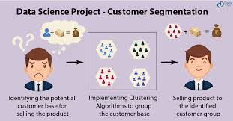
Customer Segmentation

Slide 2
introduction
The system we have been working with in this project is the Data SCIENCE project.
The application is designed to bring same customer group together on the basis of their age, choice, location.

Slide 3
Data science
Data science is an inter-disciplinary field that uses scientific methods, processes, algorithms and systems to extract knowledge and insights from many structural and unstructured data.
Data science is a "concept to unify statistics, data analysis, machine learning, domain knowledge and their related methods" in order to "understand and analyze actual phenomena" with data.

Slide 4
Applications
Can Be Used In organizations And Companies To know different group of customers .
Makes Learning Easy For every group of customer.
Different aged group can be separated.
Scope in medical field also.

Slide 5
Software Requirement
Framework:jupyter notebook
Matplotlib, pandas
4GB RAM
CPU:1Ghz
2 GB Storage
Browser: Chrome/Edge

Slide 6
Advantage
Improve customer segmentation system.
Save time.
Easy Access to Customers.
Easy to Use and Update Better reputation.
More accurate statistics.
Expand Market.

Slide 7
applications
It Can Be Used In organizations And Companies To reach customers.
Access to different group of customers.
We Can reach different group customers on basis of age, location,language

Slide 8
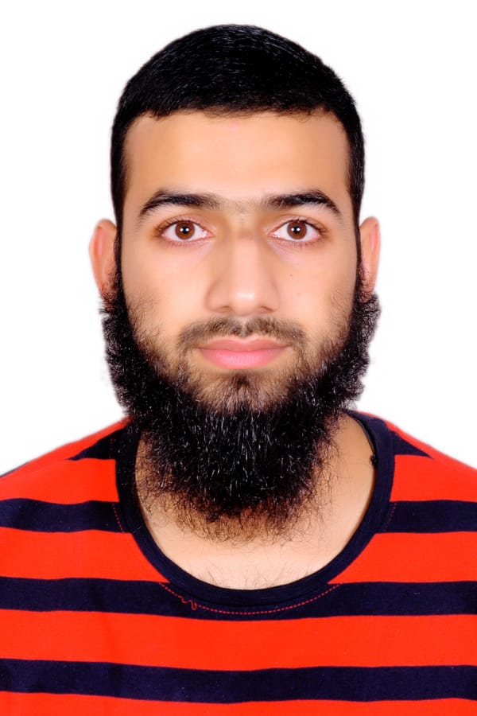


Our team members
Pallavi raushan kumar shahid gulzar ahanger yugam pahwa

